Slide 1
Industry Perspective on 2019
Michael Plunkett
President & CEO PostCom

Slide 3
Agenda
PostCom
Regulation
Legislation
Other issues
USPS/Industry interactions

Slide 4
Association for Postal Commerce
Nonprofit trade association
Representation across mailing industry
Active in industry events
MTAC, NPF, PCC
Litigation, advocacy, education, information

Slide 5
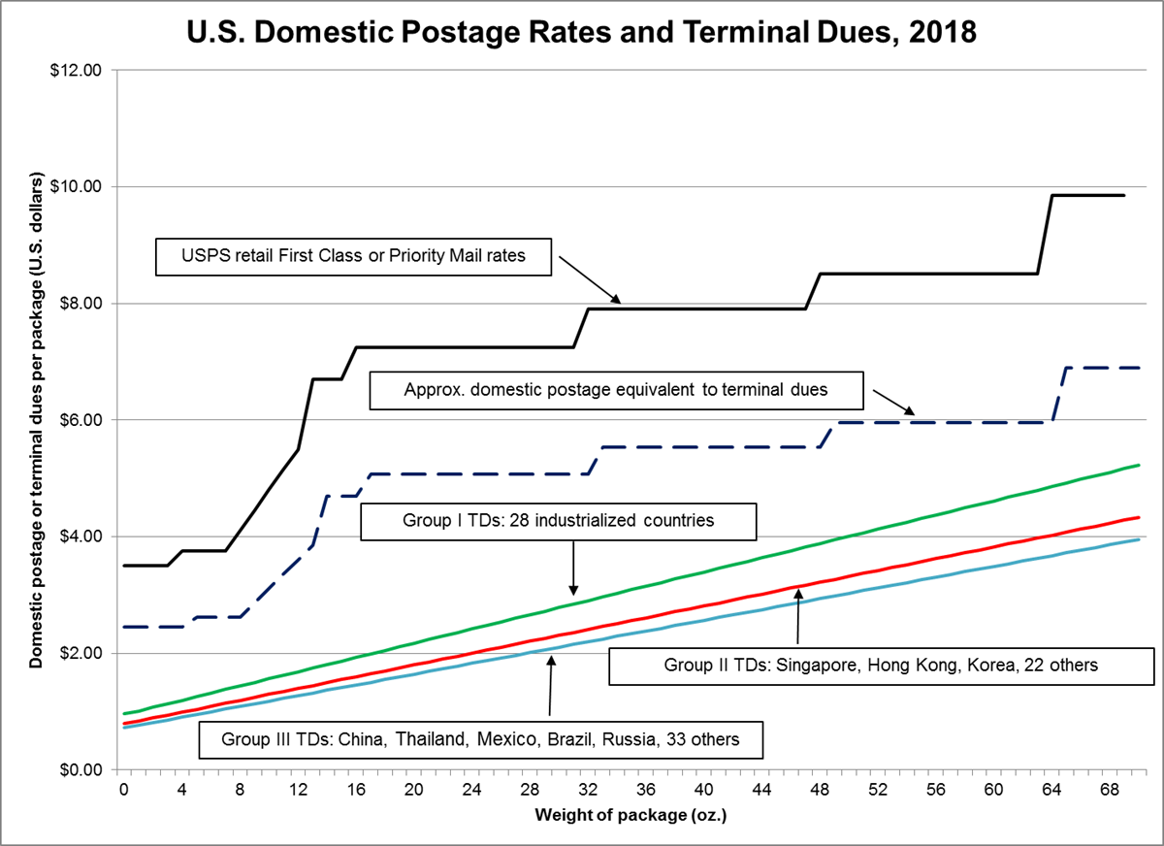
PostCom Board Meeting

Slide 6
Regulations
10-Year review of ratemaking system
Self-declaration of inbound international rates
PRC ongoing review of flats
Transfer of products
Marketing mail contents
FRN on items containing liquids

Slide 7
Legislative/Governmental Issues
Prospects for reform
Other meddling/interference
President’s Task Force
Other Administration actions
New Governors
Hearings soon?

Slide 8
Other Issues
Economic outlook
Competition for shipping business
USPS leadership changes
Technology developments
Autonomous vehicles
Improvements in mail substitutes

Slide 9
USPS/Industry Interaction
Recent challenges
Liquids
Marketing mail content restrictions
Looming issues
EPS migration
Seamless mandate
Informed address
Privacy legislation

Slide 10
Contact Us
michaelplunkett@postcom.org
Etalbott@postcom.org
www.postcom.org
@PostCom2

